Slide 1

MIS4486 Project
İstanbul Ümraniye Public Hospital Neighborhood
Görkem Özyurt
218MI1034

Slide 2
Contents
The aim of the study
Study Area
Legend
Spatial Analysis

Slide 3
The aim of the study
The aim of the study is to digitize the surroundings of Ümraniye Public Hospital.
Is there enough parking capacity around the hospital?
Checking Pharmacies within 120 meters of hospital, so we can check do patients have easy access to medicines.
do the restaurants around the gym have healthy food?

Slide 4
Study Area
İstanbul Ümraniye public hospital Neighborhood
Total : 156 Object
Cafe & Restaurant: 17
University: 1
Parking Areas: 4
Markets: 10
Pharmacy: 18
Mosque: 2
Helicopter area: 1
Roads: 26
Primary school: 1
Sport Center: 1
Houses: 74
Hospital: 1

Slide 5
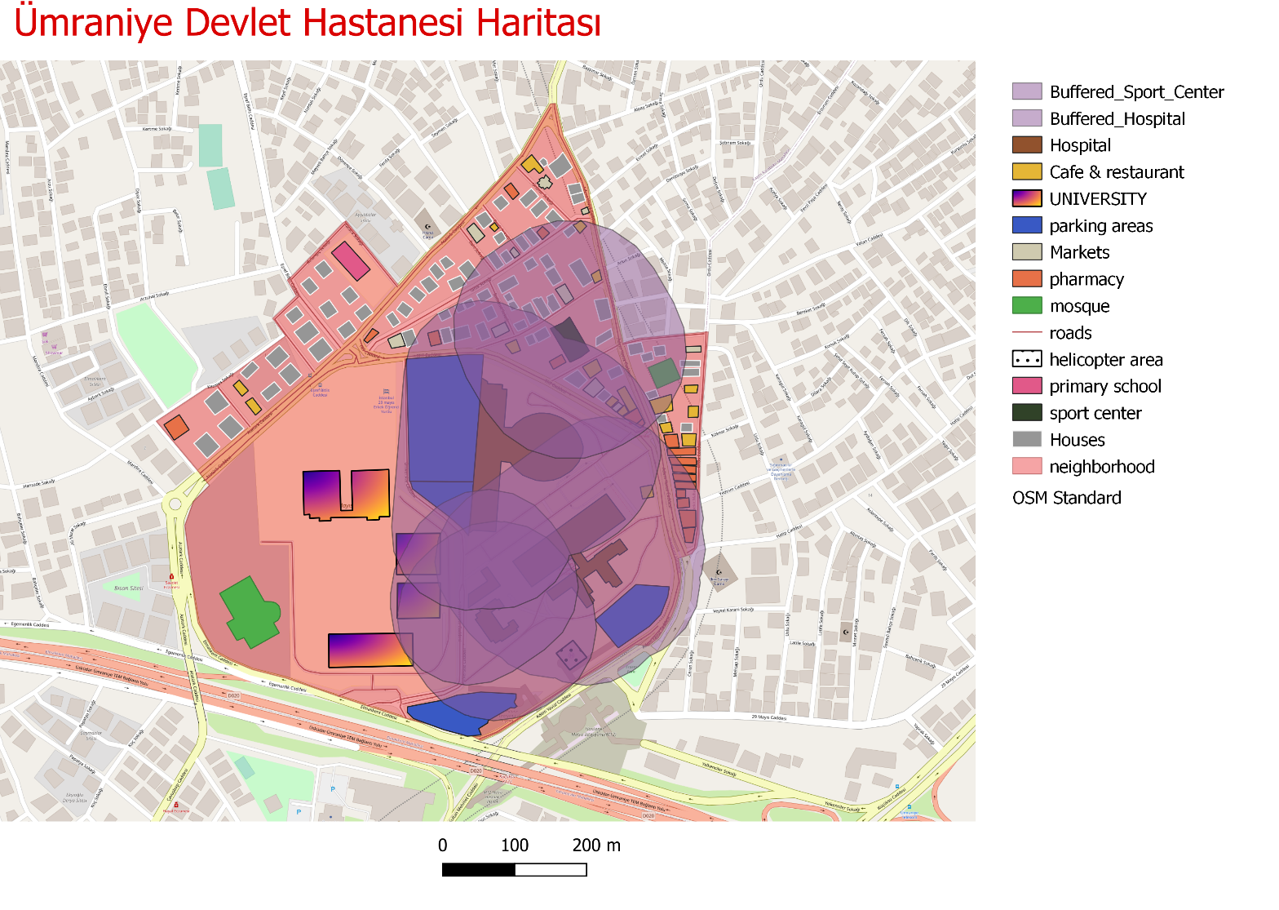
Legend

Slide 6
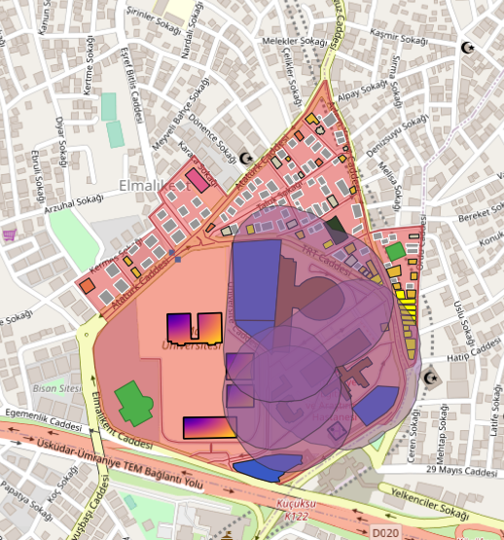
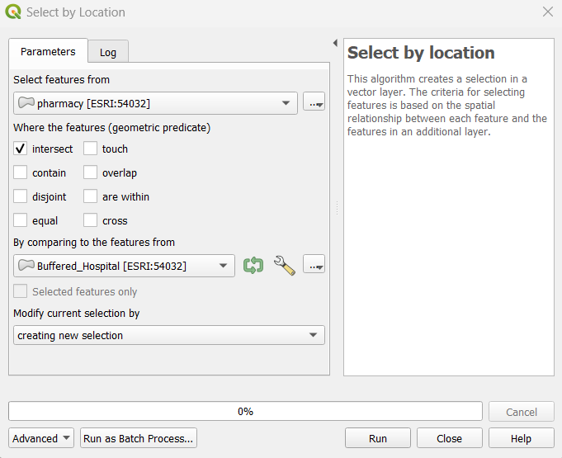
Spatial Analysis
Analysis 1:
How many pharmacies within 120 meters of hospital?
First of all, A buffer zone of 120 meters in diameter has been determined around the Ümraniye public hospital
The Created Buffer Zone was intersected with the pharmacy layer( by using Select by location)
There are 14 features selected. So there are 14 pharmacy in 120 meters of hospital

Slide 7
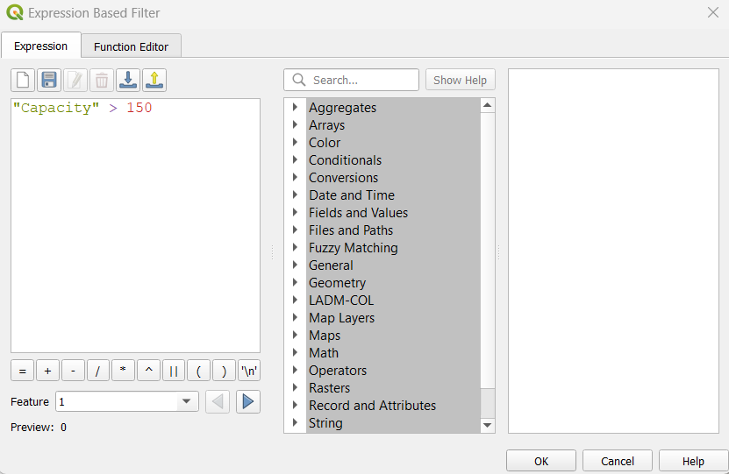
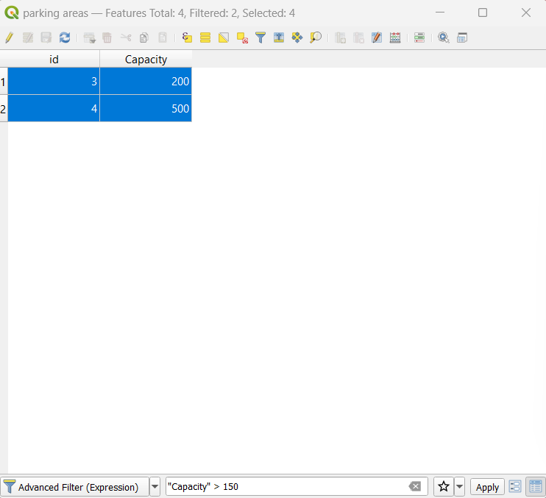
Spatial Analysis
Analysis 2:
How many parking areas are 120 meters away from hospitals with a capacity of more than 150?
Firstly, Created buffer within 120 meters for Hospital,
Intersected with buffer and parking areas;
Attiribute query : I found the parking areas which have more than 150 capacity
Analysis results:
There are 2 parking areas are 120 meters away from hospitals with a capacity of more than 150

Slide 8
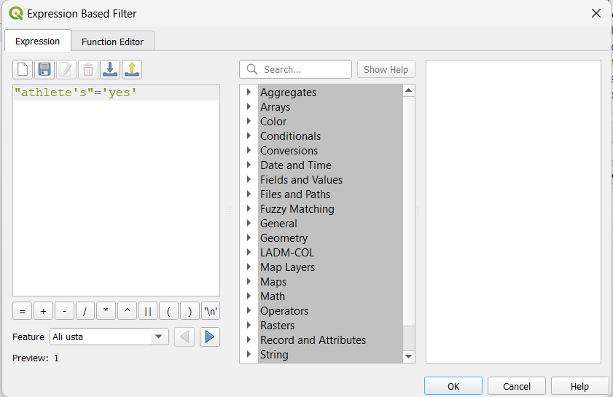
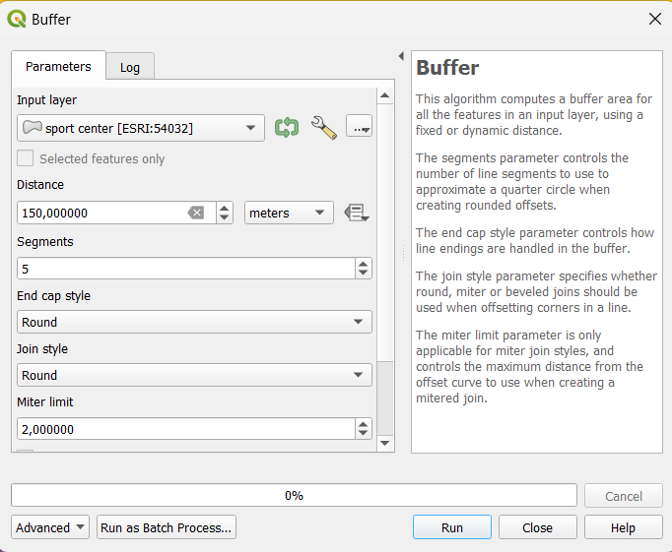
Spatial Analysis
Analysis 3:
do the Cafe&restaurants around the gym have Athlete’s meal within 150 meters?
Firstly, Created buffer within 150 meters for Sport center,
Attiribute query : I found the Cafe&restaurants
which have Athlethe’s meal.
Analysis results:
There are 6 cafe&restaurants in buffer areas and just 2 of them have Athlete’s meal

Slide 9
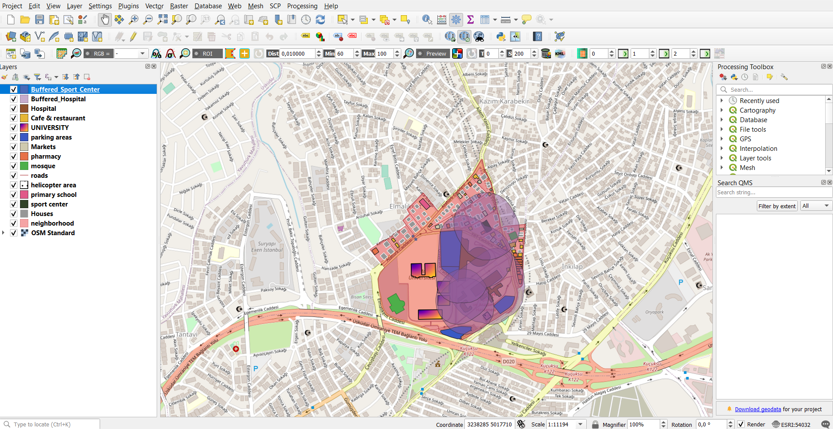
General View

Slide 10
THANK YOU FOR LİSTENİNG…

